Slide 1
Sequence diagram

Slide 2


Slide 3
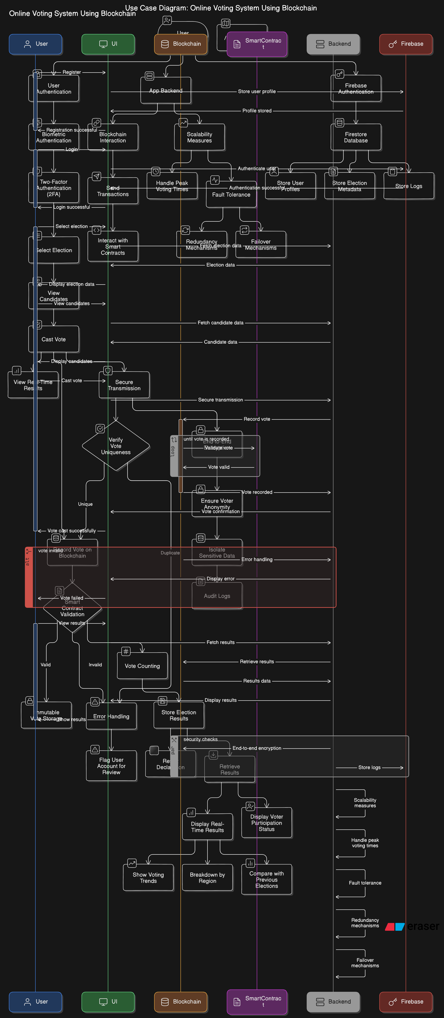



Slide 4
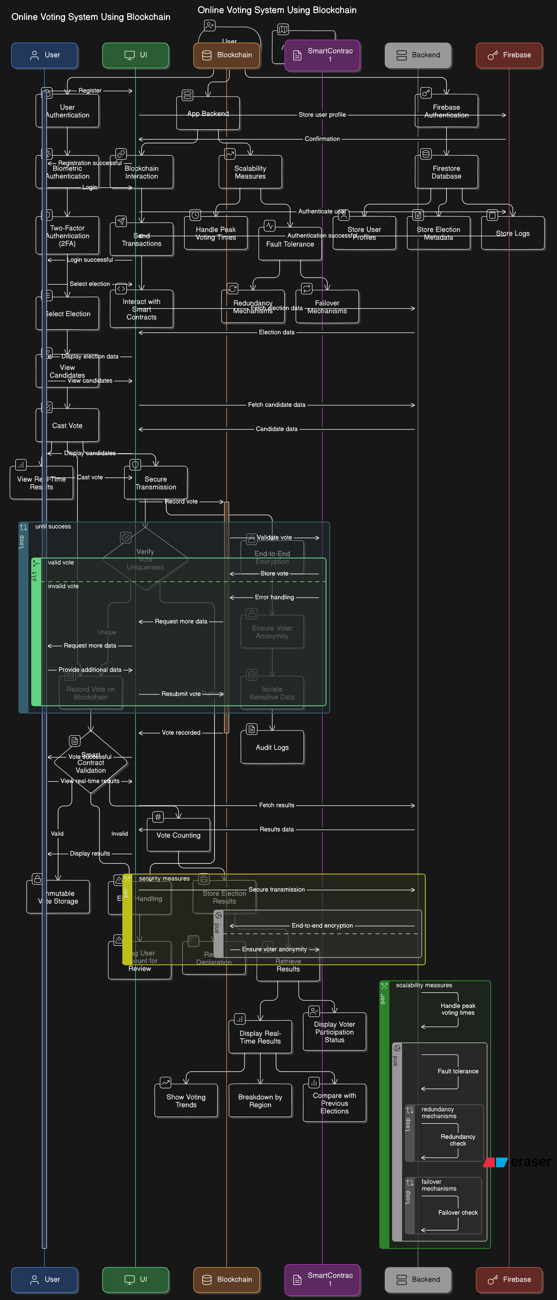



Slide 5
Use Case Diagram
PENDING

Slide 6
DFD 0 Diagram
PENDING

Slide 7
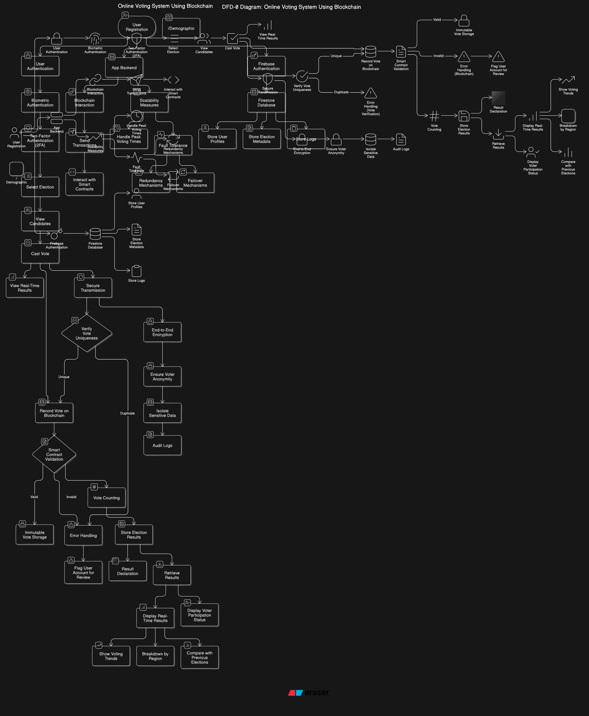



Slide 8
